Slide 1



19CSE301 COMPUTER NETWORKS
3-0-3 4

Slide 2

Network Protocols

Slide 3
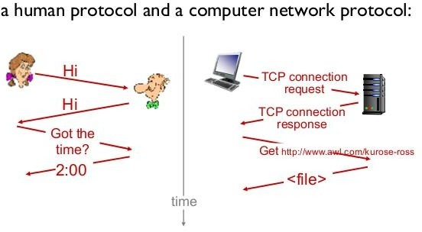
Analogy
A network protocol is similar to a human protocol, except that the entities exchanging messages and
taking actions are hardware or software components of a computer network
All activity in the Internet that involves two or more communicating remote entities is governed by a protocol

Slide 4
What is a network protocol?
A protocol is a set of rules specifying how computers should communicate with each other over a network.
It defines a common format and set of rules for exchanging messages between devices.
Are implemented by end devices and intermediary devices in software, hardware, or both.
Each network protocol has its own function, format, and rules for communications.For example,
the Transmission Control Protocol has a rule that if one computer sends data to another computer, the destination computer should let the source computer know if any data was missing so the source computer can re-send it.
Or the Internet Protocol which specifies how computers should route information to
other computers by attaching addresses onto the data it sends.
TCP/IP is a set of standardized rules that allow computers to communicate on a network such as the internet

Slide 5
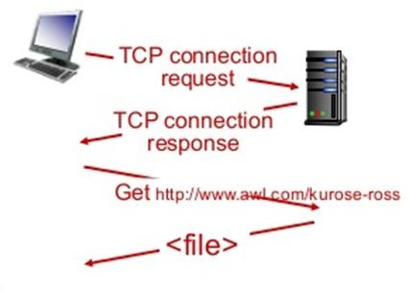
Protocol :What happens when you make a request to a WWW
server?
when you type in the URL of a WWW page into your web browser.
First, your computer will send a so-called "connection request" message to the WWW server and wait for a reply.
The WWW server will eventually receive your connection request message and return a "connection reply" message.
Knowing that it is now OK to request the WWW document, your computer then sends the name of the WWW page it wants to fetch from that WWW server in a "get" message.
Finally, the WWW server returns the contents of the WWW document to your computer

Slide 6
Protocols
Protocols in routers determine a packet's path from source to destination;
hardware-implemented protocols in the network interface cards of two physically connected
computers control the flow of bits on the "wire" between the two computers;
A congestion control protocol controls the rate at which packets are transmitted between sender and receiver.
The Internet, and computer networks in general, make extensive use of protocols. Different protocols are used to accomplish different communication tasks

Slide 7
ISP -Internet Service Provider
ISP is an acronym that stands for Internet Service Provider. An Internet Service Provider is a company that provides Internet access to organizations and home users..
ISPs are responsible for making sure you can access the Internet, routing Internet traffic, resolving domain names, and maintaining the network infrastructure that makes Internet access possible.
While the core function of an ISP is to provide Internet access, many ISPs do much more. ISPs also offer services like web hosting, domain name registration, and email services
There are 3 levels of Internet Service Provider (ISP): Tier-1 ISP, Tier-2 ISP, and Tier-3 ISP.

Slide 8
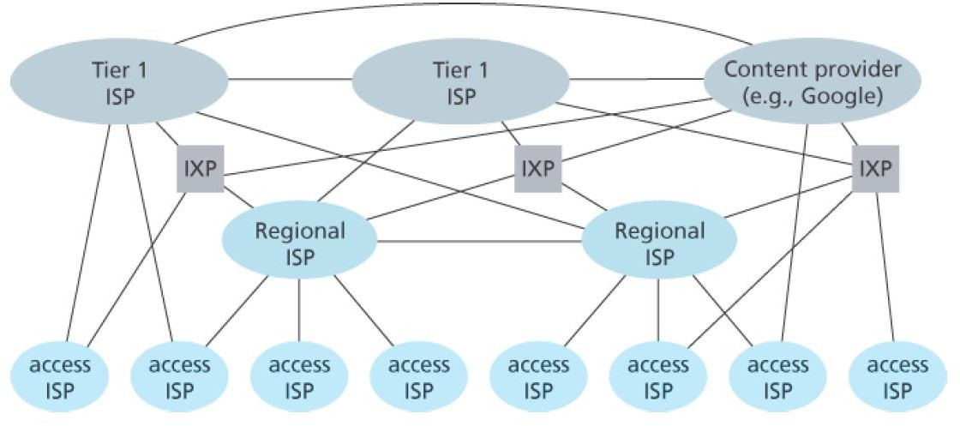
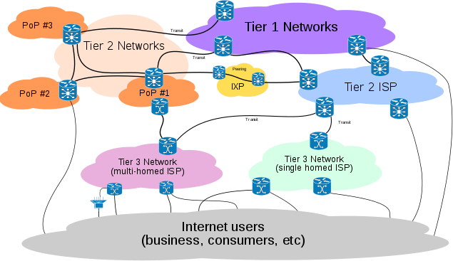
Internet Service Provider
Tier 1 Internet service providers sell access to their networks to Tier 2 ISPs. Tier 2 ISPs then sell Internet access to organizations and home users. However, sometimes Tier 1 ISPs may sell Internet access directly to organizations and individuals.

Slide 9
Tier 1 ISPs- networks that are the backbone of the Internet.
These ISPs are at the top of the hierarchy and they have a global reach they do not pay for any internet traffic through their network instead lower-tier ISPs have to pay a cost for passing their traffic from one geolocation to another which is not under the reach of that ISPs.
Cogent Communications, Hibernia Networks, AT&TVerizon, Sprint, NTT, Singtel, PCCW, Telstra, Deutsche Telekom and British Telecom, Tata Communications
They don't pay to have their traffic delivered though similar-sized networks.
They can deliver traffic to the entire Internet routing table solely through their peering relationships.
They peer on more than one continent.
They own or lease transoceanic fiber optic transport.
They deliver packets to and from customers and to and from peers around the world.

Slide 10
Tier 2 ISPs
These ISPs are service provider who connect between tier 1 and tier 3 ISPs. They have regional or country reach and they behave just like Tier-1 ISP for Tier-3 ISPs.
Vodafone, Easynet, BT
Airtel Reliance Jio Vodafone Idea BSNL
A Tier 2 ISP is a service provider that utilizes a combination of paid transit via Tier 1 ISPs and peering with other Tier 2 ISPs to deliver Internet traffic to end customers through Tier 3 ISPs. Tier 2 ISPs are typically regional or national providers.

Slide 11
Tier-3 ISP
These ISPs are closest to the end users and helps them to connect to the internet by charging some money. These ISPs work on purchasing model. These ISPs have to pay some cost to Tier-2 ISPs based on traffic generated.
Comcast, Deutsche Telekom, Verizon Communications
local cable operator or a broadband service company

Slide 12





